Slide 1
$unwind

Slide 2
$unwind
$unwind takes an array attribute, and returns one document for each element in the array.
$unwind is used to “flatten” documents with arrays into a more table-like structure suitable for further analysis

Slide 3
High level syntax
{$unwind:{arrayElement}}

Slide 4
High level syntax
{$project:{newField:”$oldField”
…
}}

Slide 5
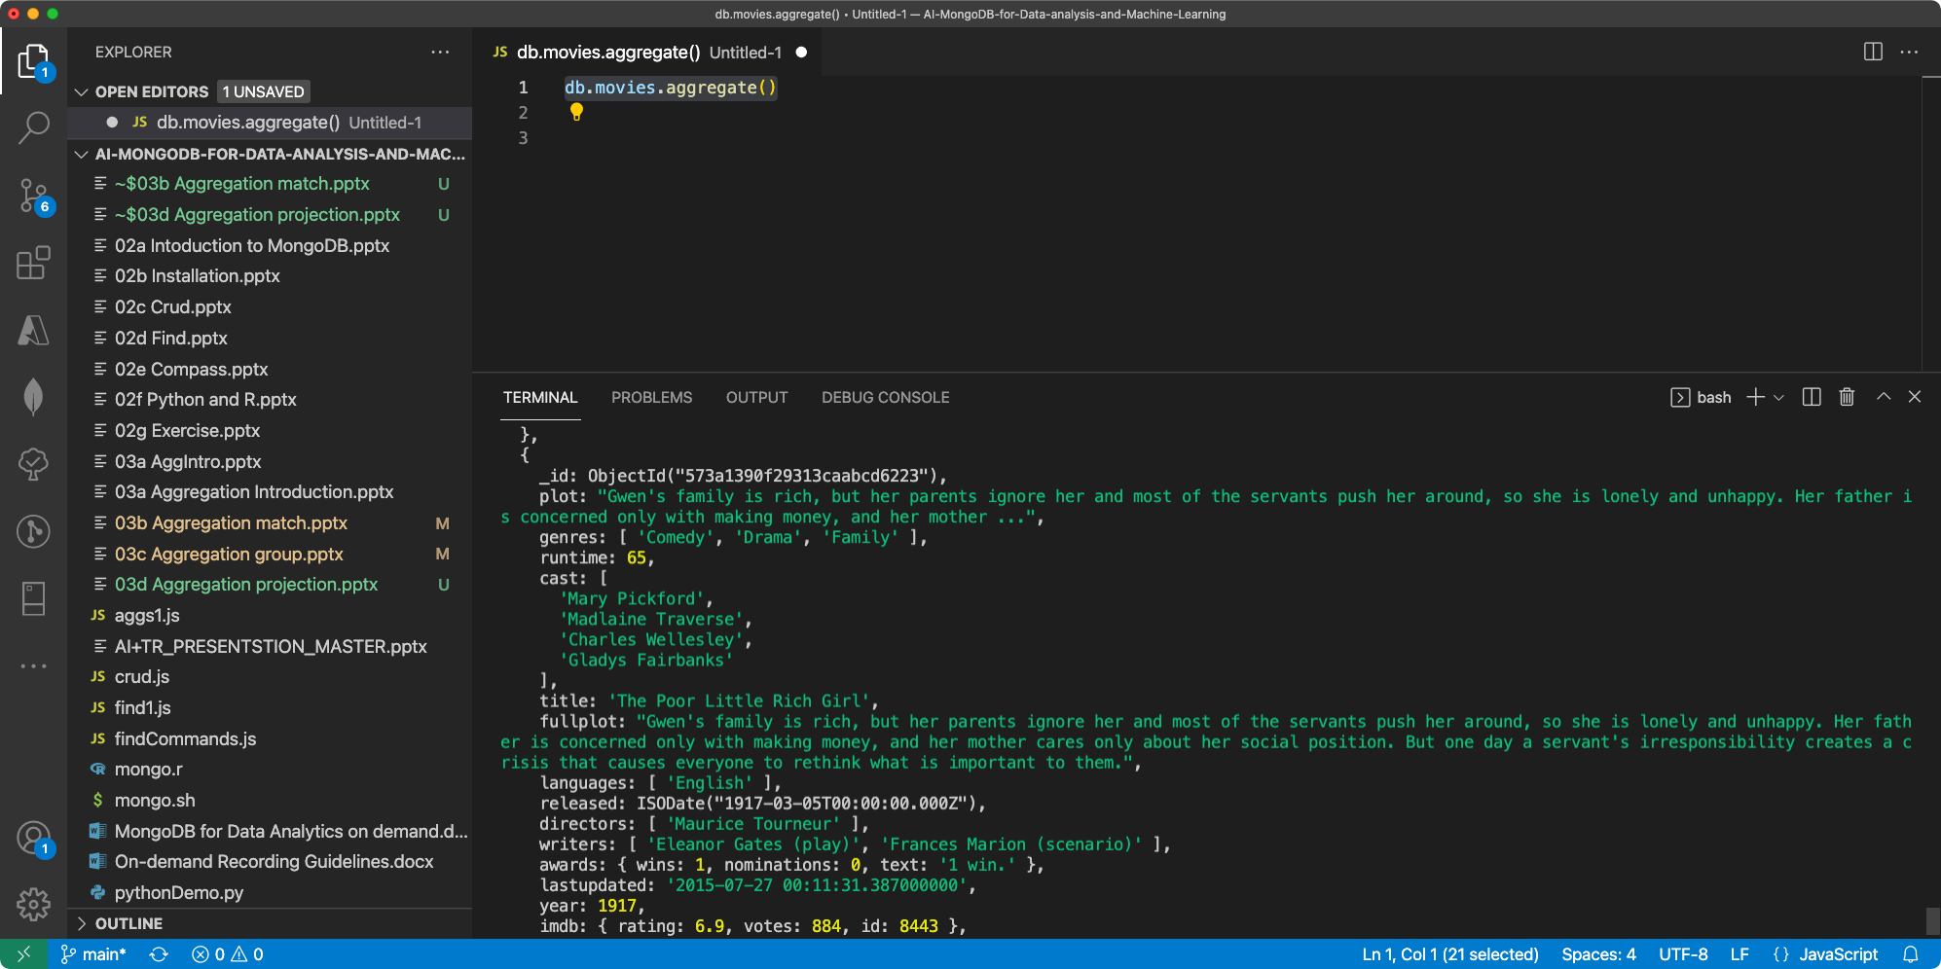

Slide 6
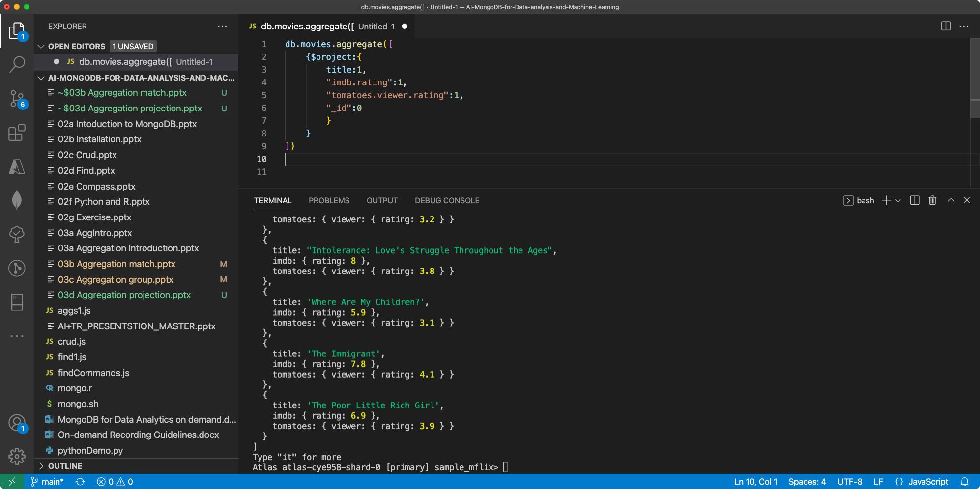

Slide 7
